Slide 1

Airline passenger satisfaction
Aya Selim/November 24,2023

Slide 2
Introduction:airline passenger satisfaction
In the ever-evolving aviation industry, understanding and optimizing the passenger experience are critical elements for airline success. The Airline Passenger Satisfaction Data Analysis Project is a comprehensive endeavor aimed at uncovering valuable insights from data gathered through passenger feedback surveys, customer reviews, and operational records.
This project acknowledges the pivotal role that passenger satisfaction plays in shaping an airline's reputation and fostering customer loyalty. By applying advanced data analysis techniques, we seek to unravel patterns and trends within the vast dataset, focusing on key aspects such as in-flight services, staff interactions, cleanliness, and punctuality.
Our objective is to not only quantify the overall satisfaction levels but also to identify the driving factors that significantly influence passengers' perceptions. Through this analysis, we aspire to provide actionable recommendations for the airline industry, enabling companies to enhance specific areas of their services and address pain points that may impact customer satisfaction.

Slide 3
Project objectives
Identify Key Factors: Conduct an in-depth analysis to identify and prioritize the key factors influencing airline passenger satisfaction. This includes examining variables such as in-flight services, staff behavior, cleanliness, and punctuality.
Quantify Overall Satisfaction Levels: Quantify and understand the overall satisfaction levels of airline passengers. Utilize statistical methods to provide a comprehensive view of the distribution of satisfaction scores.
Explore Correlations: Investigate correlations between different aspects of the passenger experience. Understand how variables such as on-time performance might impact the overall perception of services.
Factor Analysis: Apply factor analysis techniques to discern underlying factors that contribute significantly to passenger satisfaction. This involves identifying latent variables that are not directly observable but have a substantial impact on the overall experience.

Slide 4
Data analysis methods
Utilize descriptive statistical measures to summarize and present key characteristics of the dataset. This includes mean satisfaction scores, standard deviations, and other relevant metrics.
Descriptive statistics
Exploratory data analysis(eda)
Conduct EDA to visually explore the dataset. Employ charts, histograms, and heatmaps to identify patterns, outliers, and relationships between different variables.
Analysis methods
Perform correlation analysis to examine relationships between various aspects of the passenger experience. Understand how factors like in-flight services, staff behavior, and cleanliness correlate with overall satisfaction.
Correlation analysis

Slide 5
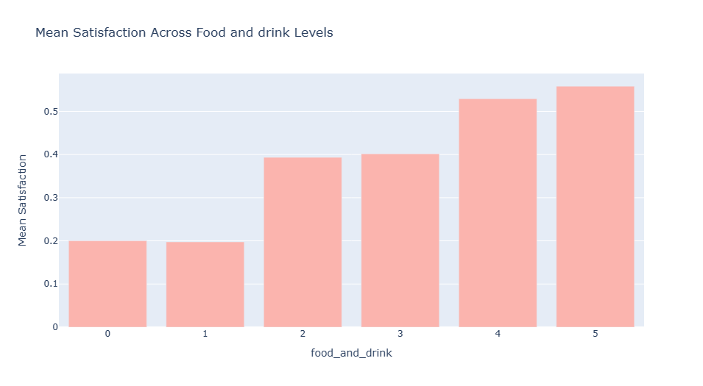
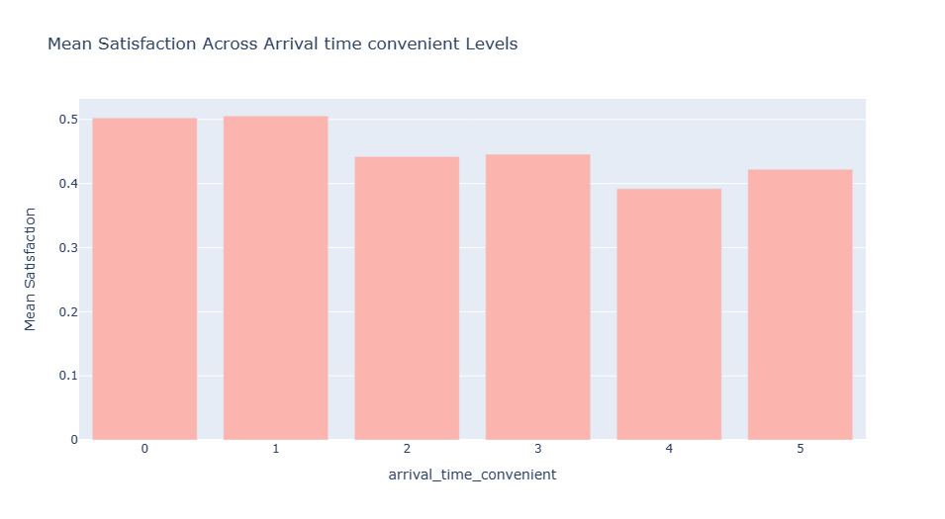
Exploratory data analysis (Eda)
Histogram of satisfaction scores for all airline services
There’s some people who give 0 to food and drink are satisfied which mean no matter Affects satisfaction
Most of those who give 0 to Arrival time convenient on the plane are satisfied with the flight. It seems that wifi service is not that important.

Slide 6
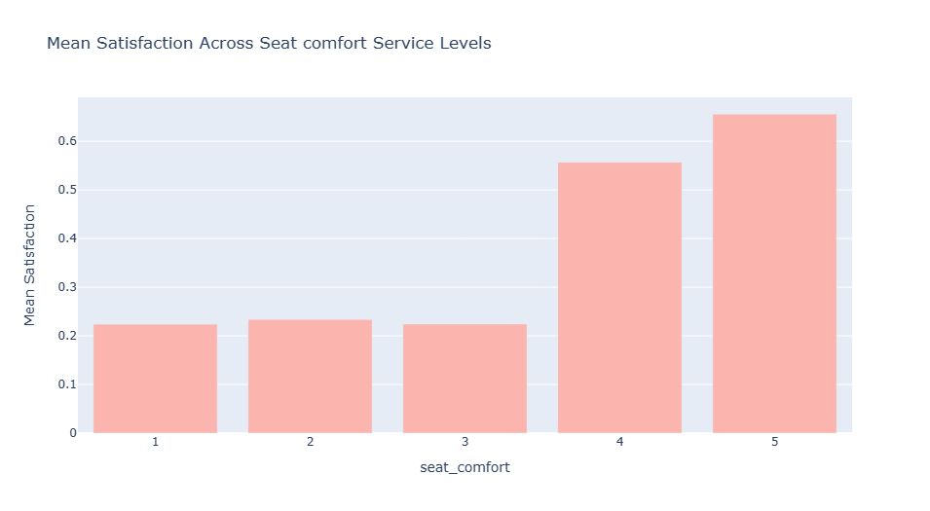
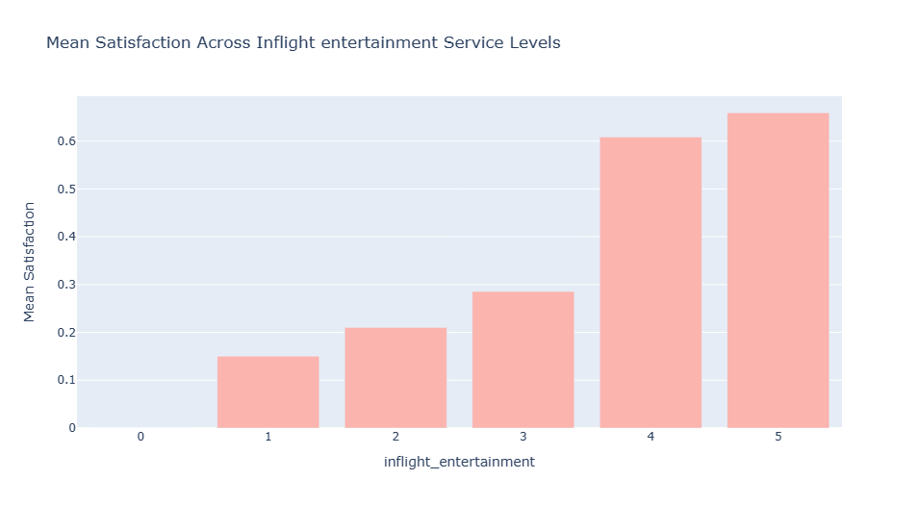
Exploratory data analysis (Eda)
Histogram of satisfaction scores for all airline services
Most of those who give 5 points to seat comfort are satisfied with the flight
Most of those who give 5 points to Inflight entertainment are satisfied with the flight and There is no one that gives the Inflight entertainment 0 points.

Slide 7
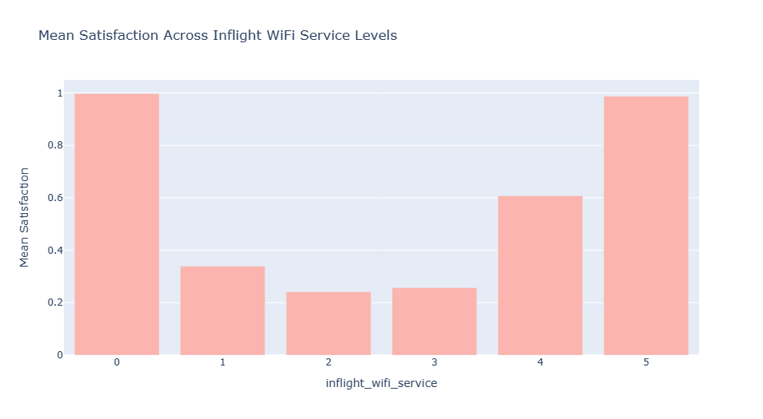
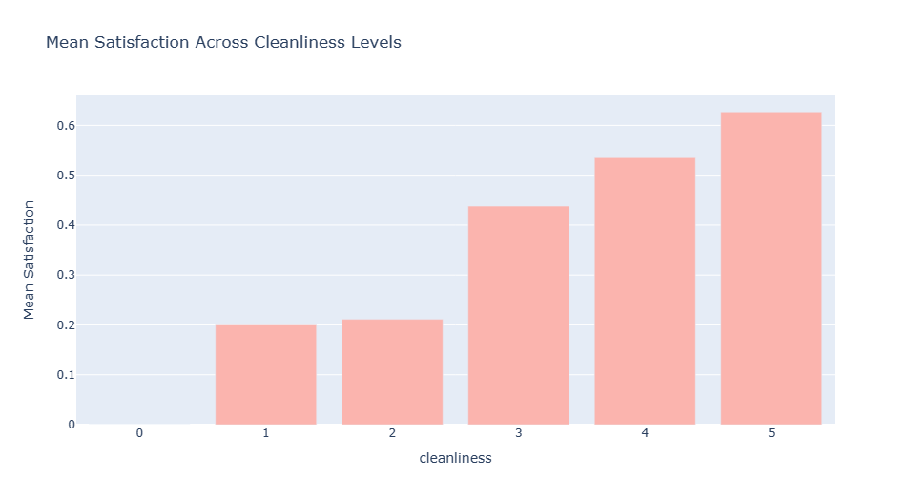
Exploratory data analysis (Eda)
Histogram of satisfaction scores for all airline services
Most of those who give 0 to wifi service on the plane are satisfied with the flight. It seems that wifi service is not that important.
Most of those who give 5 points to cleanliness are satisfied with the flight.

Slide 8
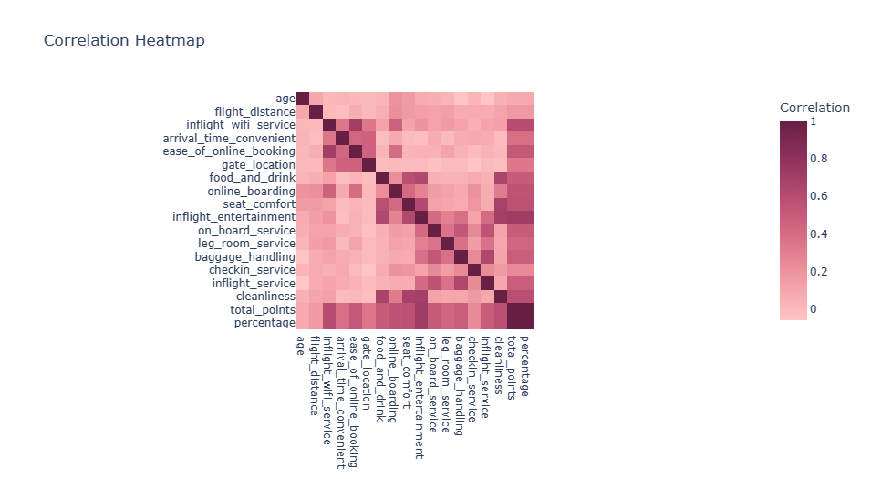
Exploratory data analysis (Eda)
Heatmap showing correlation between variables.

Slide 9
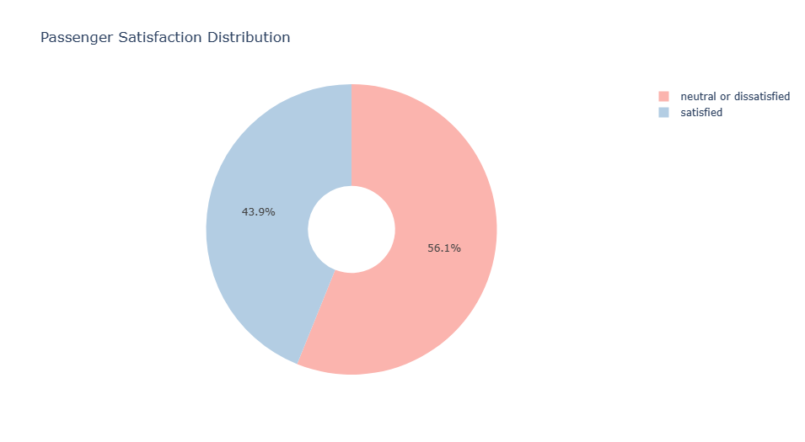
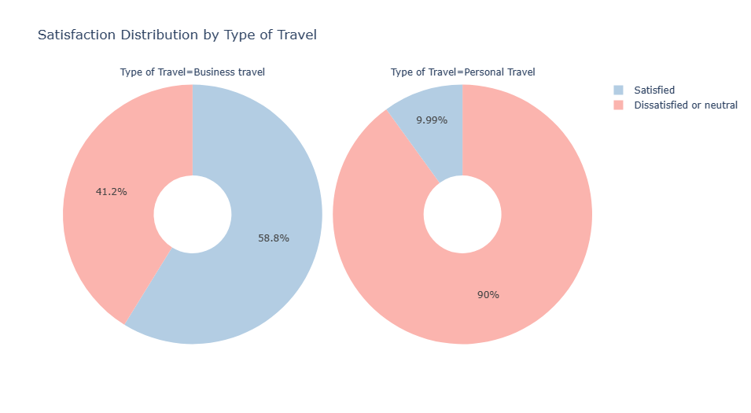
Exploratory data analysis (Eda)
Satisfaction and some factors affecting it :
56.1% of passengers neutral or dissatisfied
43.9% of passengers satisfied
Business travel: 58.8% satisfied,41.2% neutral or dissatisfied
Personal travel: 9.99% satisfied,90% neutral or dissatisfied

Slide 10
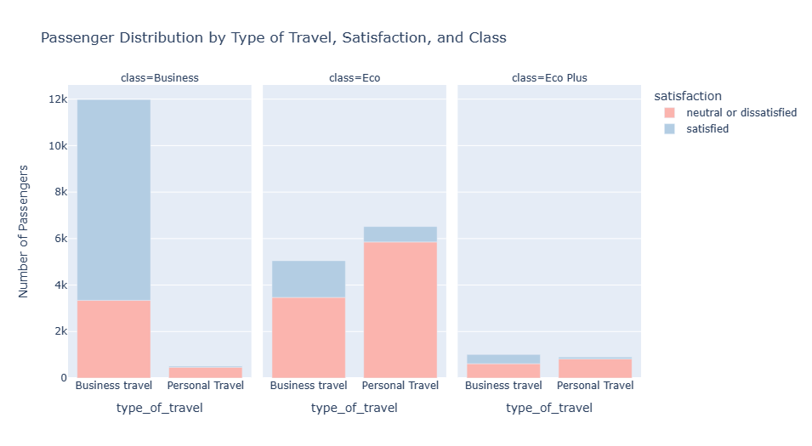
Exploratory data analysis (Eda)
Satisfaction and some factors affecting it :

Slide 11
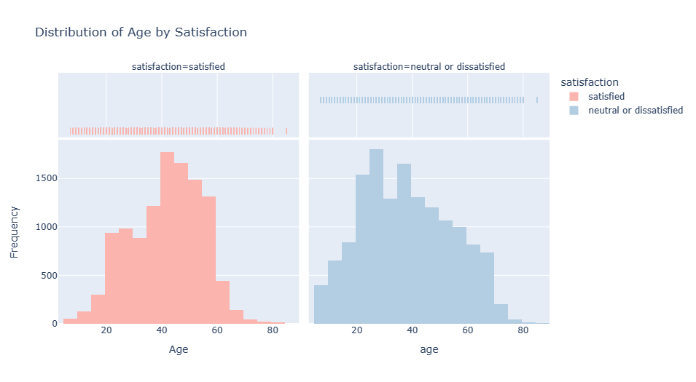
Exploratory data analysis (Eda)
Satisfaction and some factors affecting it :
The highest satisfaction rate between the ages of 40-45 and the The highest dissatisfaction rate between the ages of 25-29

Slide 12
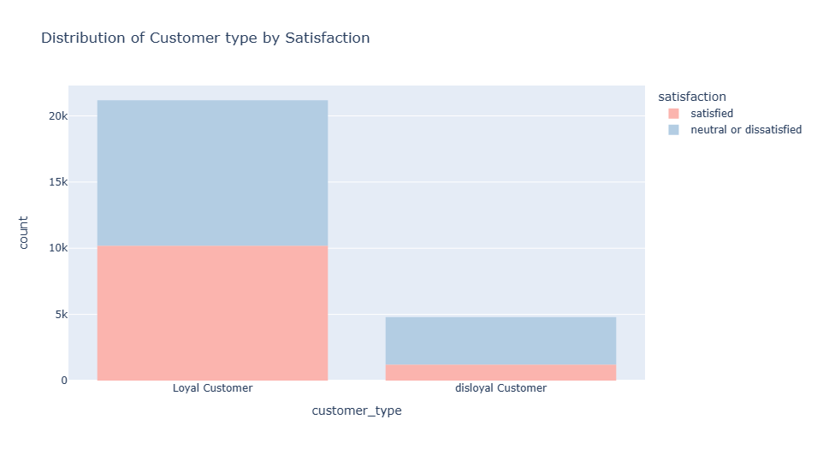
Exploratory data analysis (Eda)
Satisfaction and some factors affecting it :
Loyal Customer most satisfied than disloyal customer.

Slide 13
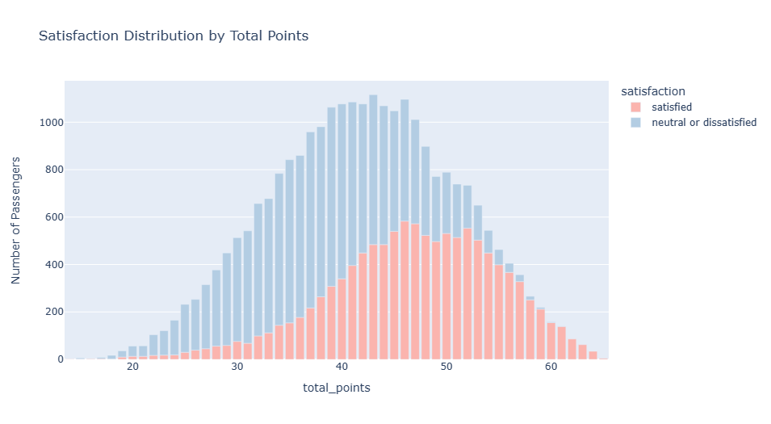
Exploratory data analysis (Eda)
Satisfaction and some factors affecting it :

Slide 14
Key finding and factor analysis
Overall Satisfaction:
56.1% of passengers reported high dissatisfaction.
43.9% of passengers reported high satisfaction.
Key Factors:
In-flight service and staff behavior were top contributors.
Factors Influencing Satisfaction:
In-flight service quality.
Staff behavior and courtesy.
Cleanliness and comfort.
Impact:
Improving these factors can significantly boost overall satisfaction.

